Slide 1



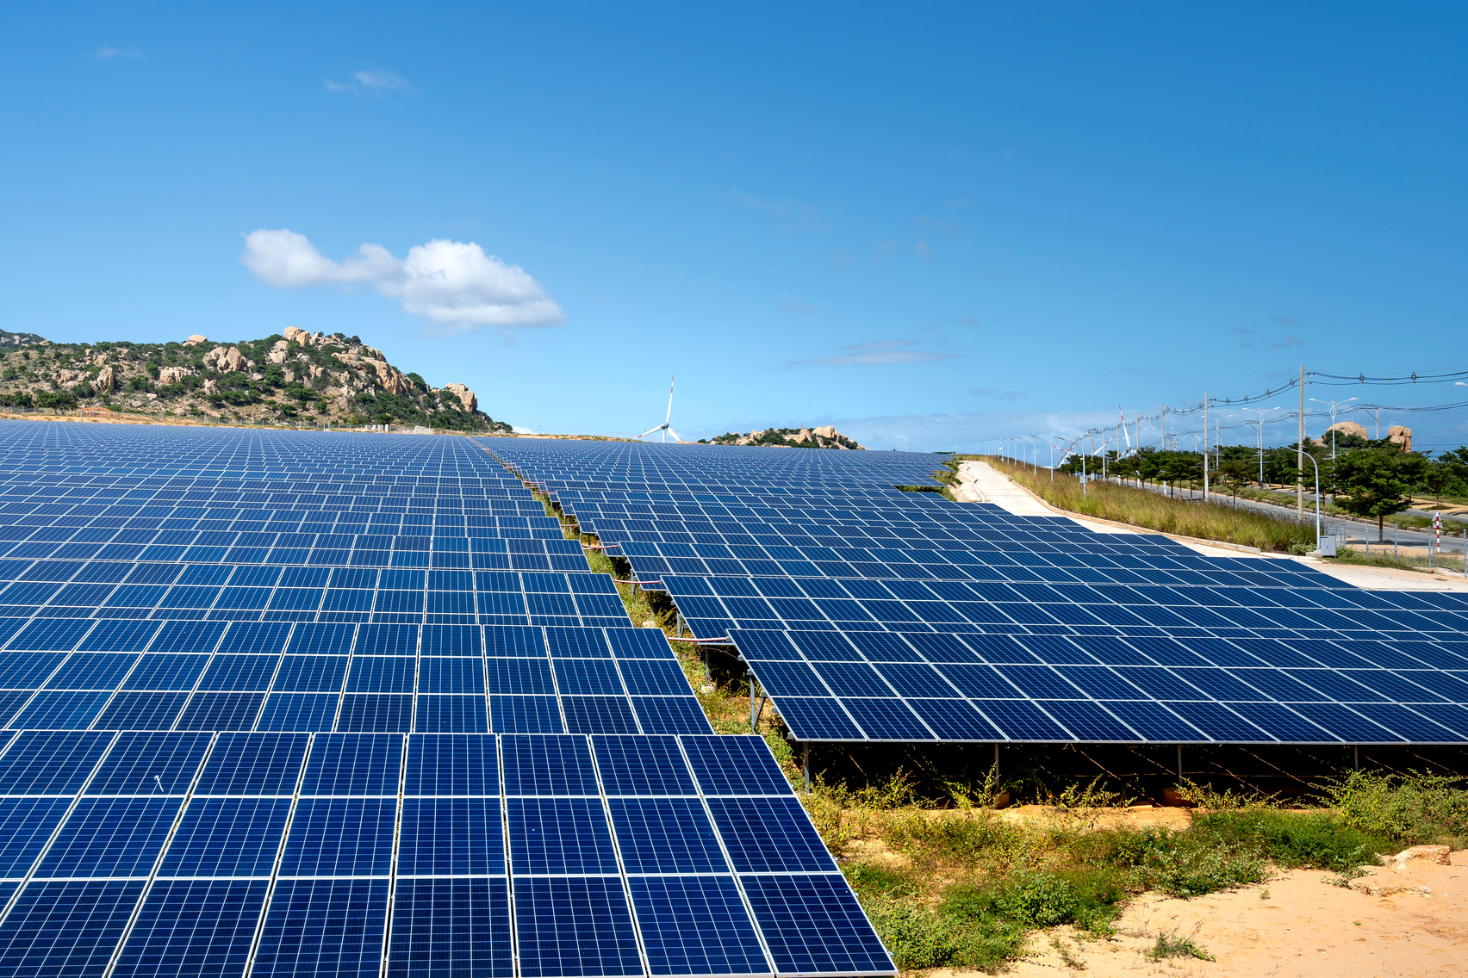

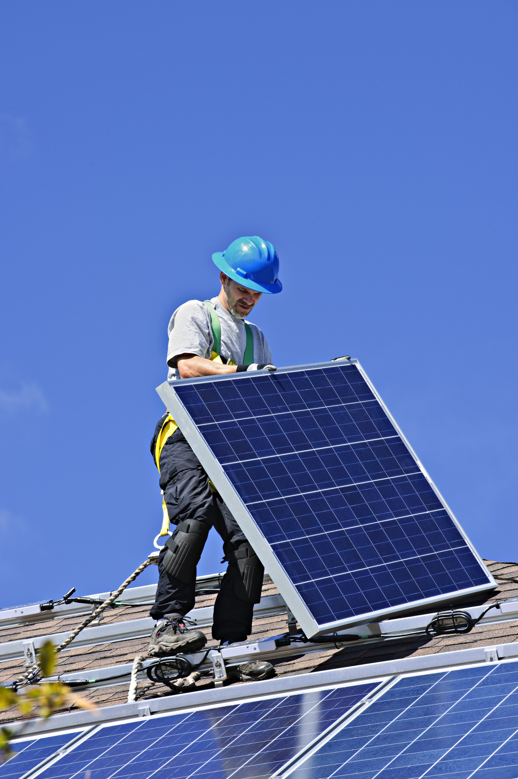




Solar Panel
Fault Detection
Since
2011
A Transfer Learning Approach using VGG16
Presented By: Team4
CIS 515: AI & Data Analytics Strategy

Slide 2

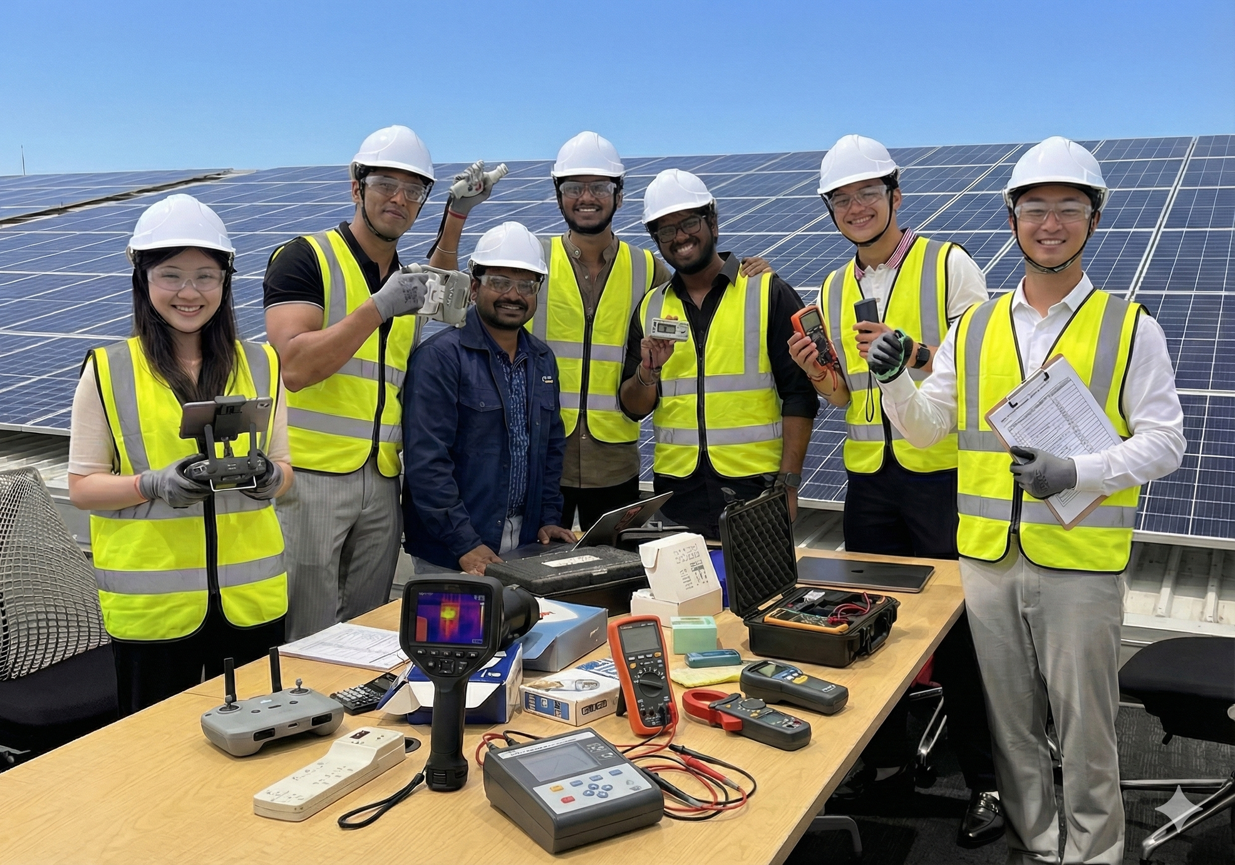

Members
Pei Wen Chen, Shardul Suryavanshi, Omkar Mahesh Pallerla, Manoharan Pavithran, Vinit Vijaykumar Adke, Mihir Kailash Khandelwal, Wei Cheng Fan

Slide 3

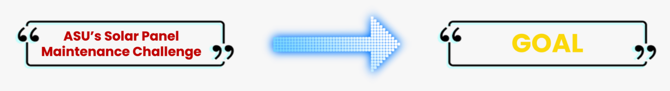

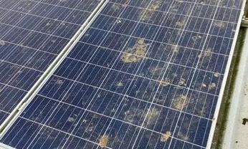
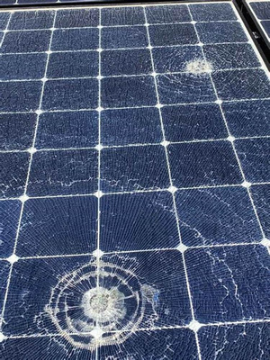
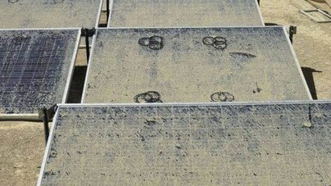
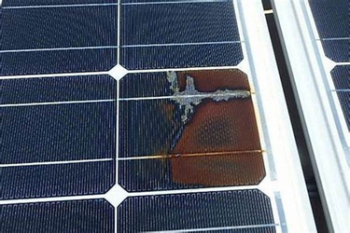

Problem Definition
Current Inspection Methods:
Slow
Costly
Labour Intensive
Difficult to scale for large solar installation
Create a CV-powered solution that helps ASU’s facilities and energy teams monitor
Maintain solar panels more easily and efficiently.
Bird Dropping
Cracks or Damages
Dust
Hotspots and electical issues

Slide 4
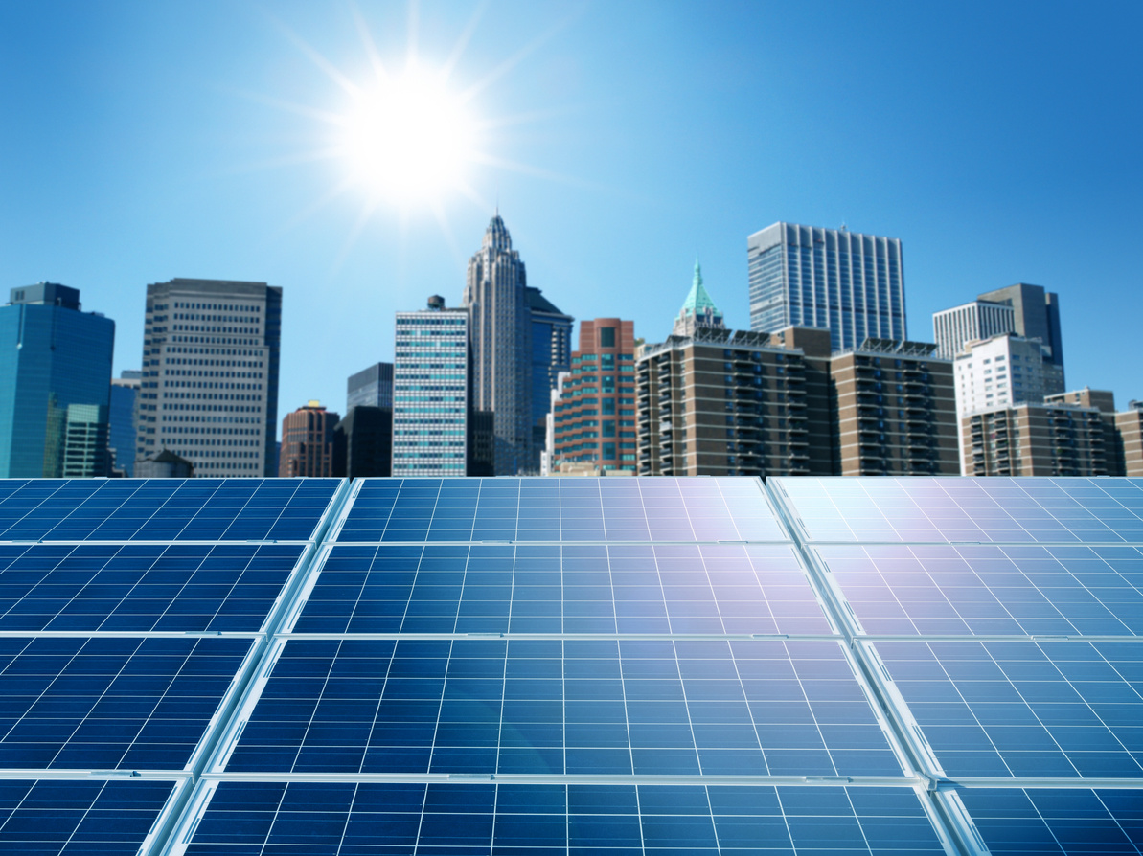
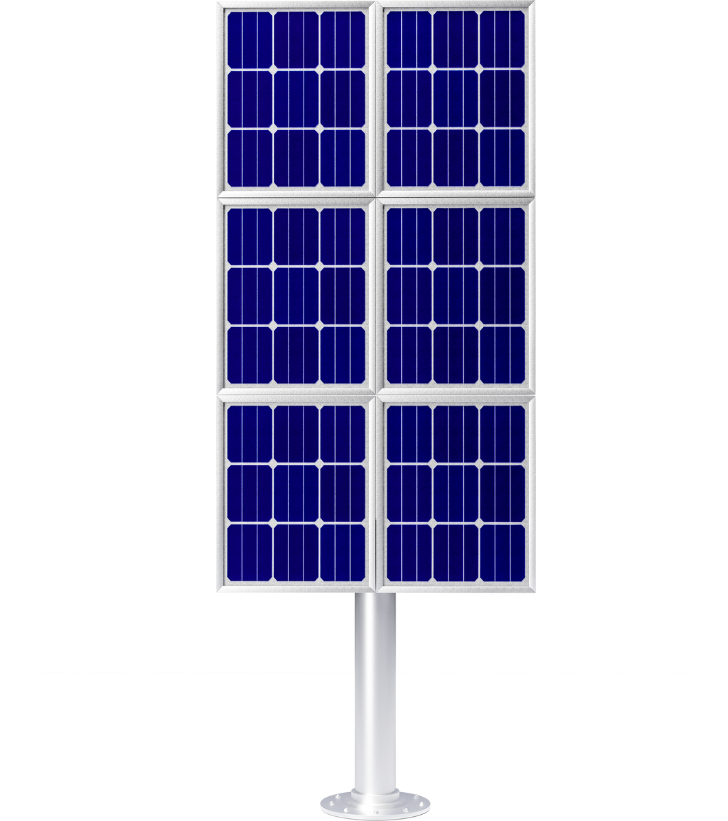
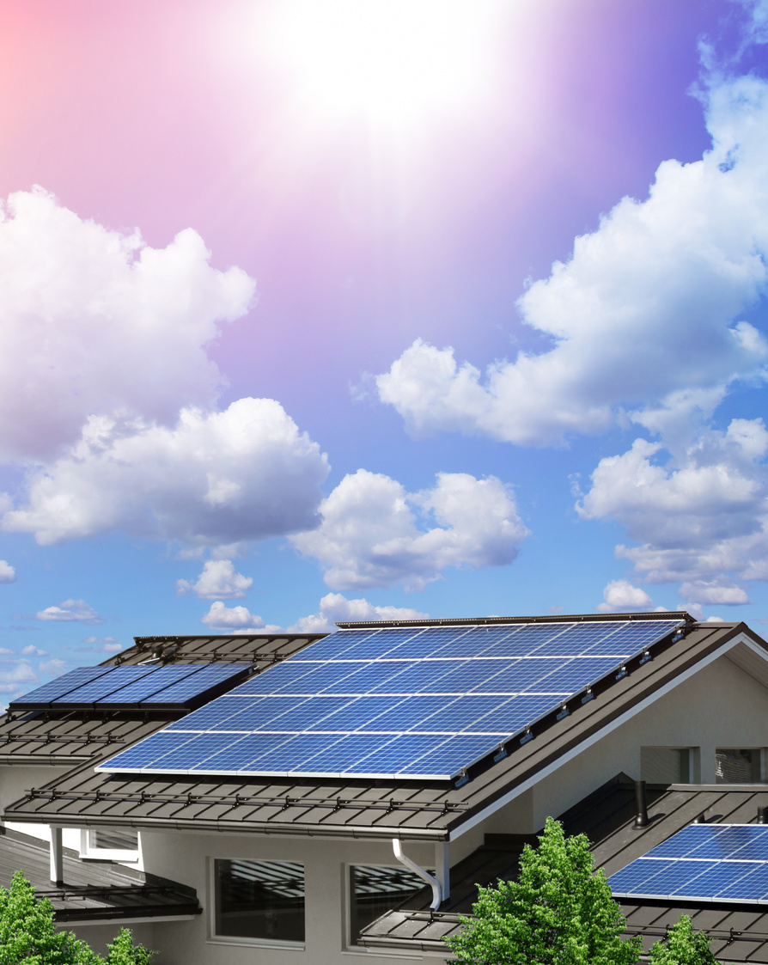
Why this matters?
Energy Production
Safety
Undetected faults reduce power output and raise energy costs
Severe faults can cause overheating, fire risk, or equipment damage
Sustainability
Scalability
ASU’s carbon and sustainability goals rely on efficient performance.
Thousands of panels make manual inspection impractical.
Computer vision automation increases inspection frequency while reducing labor cost and improving overall system reliability.

Slide 5




Stakeholders &
Beneficiaries
Primary Stakeholders
Beneficiaries
Facilities Development & Management
Operations & Maintenance Teams
School of Sustainability
Students & Faculty
Local Community
ASU Leadership
Finance & Administration

Slide 6
How it is solved today & issues with status quo
Method
Manual Visual Inspection
Electrical Performance Monitoring
Technicians walk arrays and check panels by eye.
Measures voltage / current to flag underperforming panels.
Examples
Slow, costly, and easy to miss faults.
Detects symptoms but not the root visual cause (dust?, crack? hotspot?)
Issue

Slide 7

How our solution helps & why we need Computer Vision
HOW?
WHY?
Takes regular photos of solar panels
Automatically spots dirt, cracks, hotspots, and other issues.
Finds problems early before they reduce energy or cause damage
Shows maintenance teams exactly which panels need attention
Reduces operational and maintenance costs through automated, accurate detection.
Computer vision looks at photos like human, but can check thousands of panels quickly and consistently.
CV models learn from historical images, so detection improves over time.

Slide 8








End-to-end Product Solution
01
02
03
Image Capture
Ingestion & Storage
CV Inference service
04
05
06
Dashboard & Alerts
Maintenance Workflow
Monitoring & Retaining

Slide 9
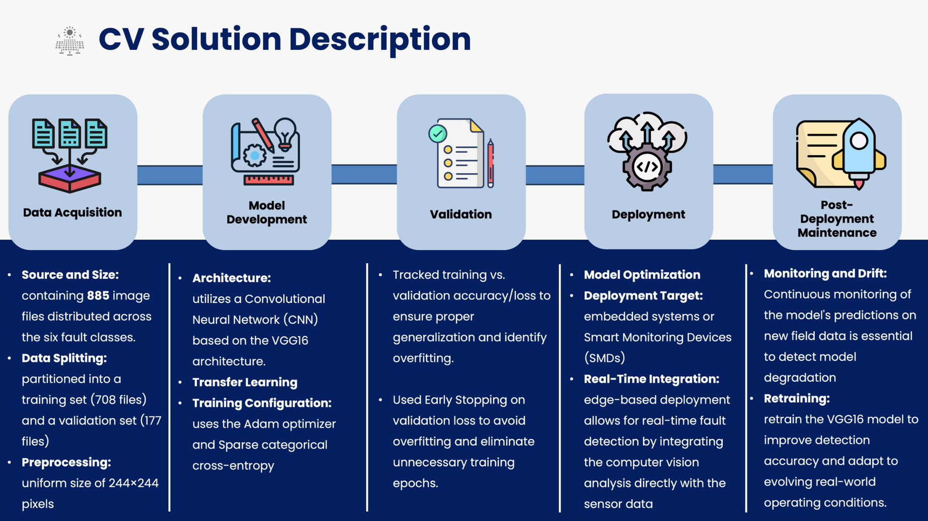

Slide 10


Model Architecture
\
Reasons behind using VGG16:
Project Apply:
Pretained on ImageNet
Deep Architecture (16 layers)
Simple and modular design
Transfer the convolutional backbone of VGG16.
Drop the original 1000-class ImageNet head.
Add a custom dense classification head for the solar panel condition classes (clean vs faulty types).
This connects directly to the Transfer Learning: Reuse pretained features, then add task-specific layers on top for our smaller dataset.
Key Architectural Characteristics:
Stacks of 3X3 convolution layers
2X2 max pooling blocks
Core Ideas:
Many small 3X3 filters instead of big 7X7 / 11X11 → more non-linearity → fewer parameters
VGG blocks: multiple 3X3 convs (same padding, stride 1) → max pool (2X2, stride 2) that halves spatial resolution each block.

Slide 11
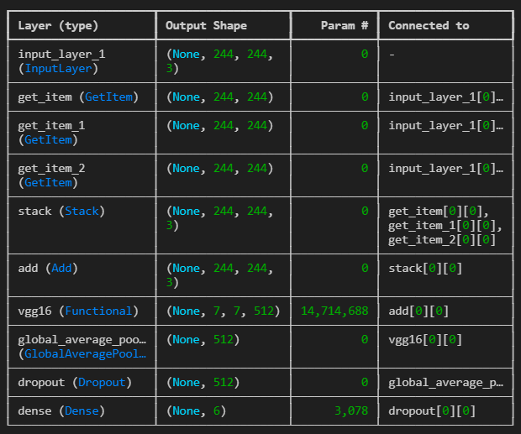
Transfer Learning Setup
Load the pre-trained Model
Freeze Early layers
Load the VGG16 model, which has been pre-trained on a large dataset like Imagenet.
Freeze the early layers of the network, which capture general features
Modify Final Layers
Fine-tune
Replace or modify the final layers to suit the new task.
Train thr newly added or modified layers on the new dataset.

Slide 12



Training Configuration & Results (VGG16)
Training setup
Data pipeline & preprocessing
Optimizer: Adam with learning rate [0.001]
Loss: categorical cross-entropy
Batch size: 32, Epochs: 15
Train / validation: 80-20% split
Resize all images to 224×224×3 to match VGG16 input size
Normalized pixel values (e.g., 0–1 or using ImageNet preprocessing)
Applied data augmentation flips to reduce overfitting
Observations
Performance
VGG16 + transfer learning performs significantly better than a scratch CNN
Overfitting controlled via frozen backbone, augmentation, and/or dropout
Best Training accuracy: ~ 97.18%
Validation accuracy: 84.75%
Validation Loss: 56.82%

Slide 13
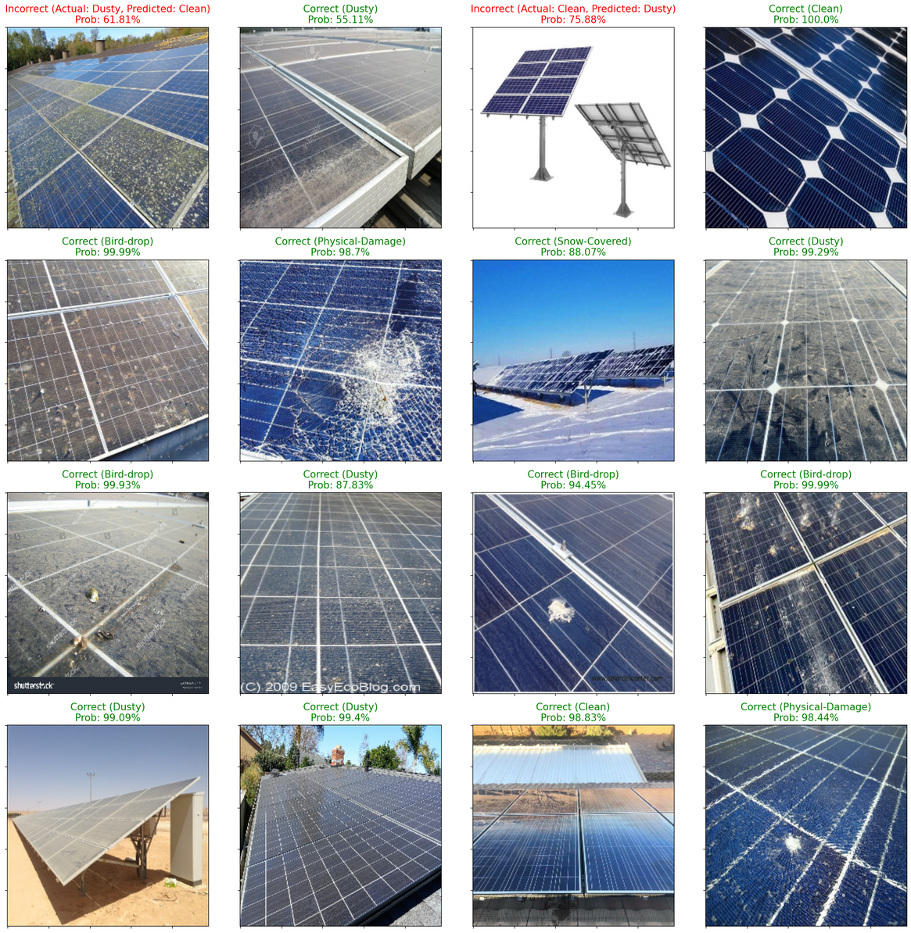
Validation Inference & Error Analysis
Key Takeaways:
Strong Generalization: Model correctly identified 14 of 16 validation images.
High Confidence: Critical defects (Physical Damage, Bird-drops) detected with >98% probability.
Identified Weaknesses:
Lighting: Glare caused confusion between "Clean" and "Dusty" (Top Left).
Data Quality: Model failed on "Stock Photos" with white backgrounds (out-of-distribution data).
Action Item: Remove unrealistic stock images and apply lighting augmentation.

Slide 14
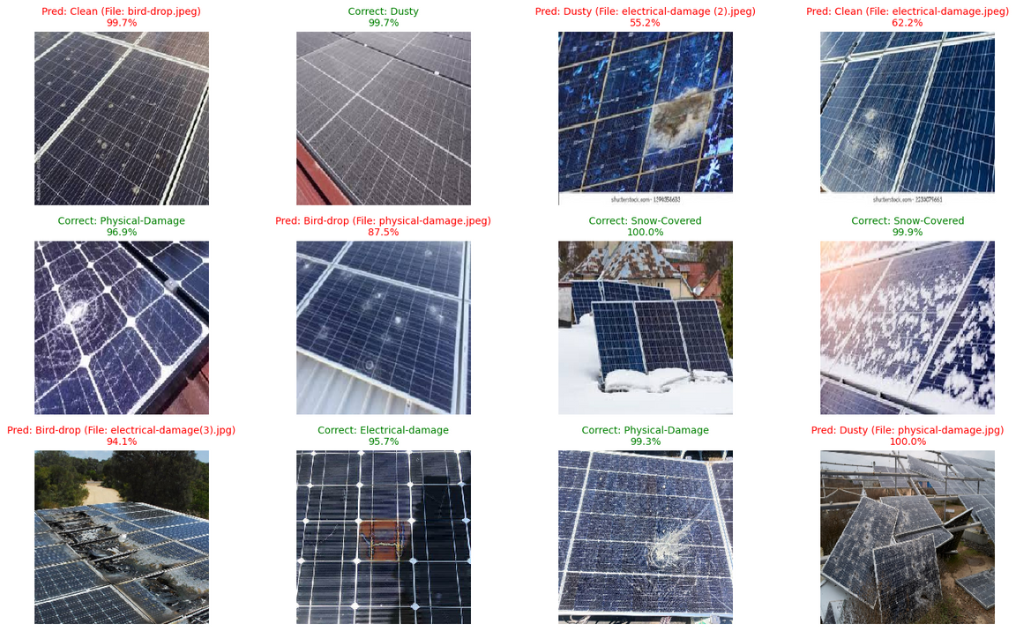
Real - World Test Data (External Source Data)
Methodology:
Tested on completely new images sourced from the internet, distinct from the training distribution.
The Reality Gap:
Accuracy drops to 50% (6/12) on external data, highlighting a 'Domain Shift' challenge.
Specific Weakness (Electrical Damage):
The model consistently misclassified
Electrical Damage. It confuses burn marks with 'Dust' or 'Bird Drops.
Successes:
Despite the new data source, the model remains 100% robust on Snow Coverage and severe Physical Damage

Slide 15

Model -> Course Concepts
CNN Architecture: VGG
Transfer Learning
We Choose VGG 16 because it’s a deep, modular CNN with 3x3 conv blocks and max pooling, exactly as covered in CNN architecture lecture.
We followed the transfer learning workflow from class: freeze backbone → add custom head → optionally fine tune deeper layers with law LR on our solar dataset.
Solution Lifecycle
Problem Definition:
Data Acquisition / Preparation
Model Building / Evaluation
Deployment / Monitoring
ASU solar perforemance and maintanence.
Kaggle solar panel image dataset, labeled clean vs faulty
VGG16 TL, careful train/val/test split, monitoring, overfitting & metrics
Deployment/
Monitioring: Design for a future ASU dashboard

Slide 16

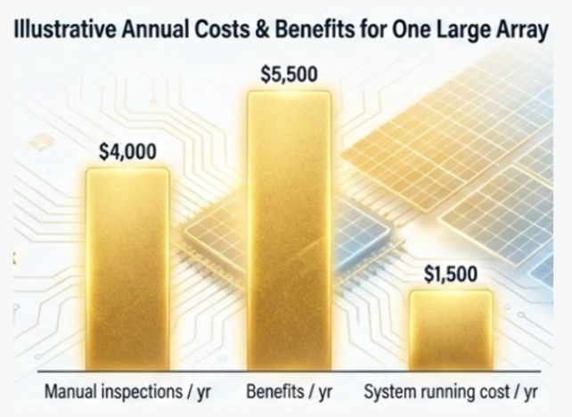
Cost-Benefit:
Is It Worth Building?
Manual Inspection:
Several full inspections per year for each large array.
Rough estimate: ~$4k/yr/array in labor & equipmnent
Our System (Post Building):
One-time build cost: ~$30k - $45k (pilot)
Ongoing running cost: ~$1.5k/yr.
Benefits:
Bottom Line:
Better fault detection → less lost energy.
Fewer manual inspections.
Worth ~$5k - $6k/yr/array.
Annual benefits (~$5k - $6k) > running cost (~$1.5k)
Initial investment pay back in about 5-7 years on 1 array, faster if used on many arrays

Slide 17




Limitations, Risks &
Mitigations
Data Limitations
Model Limitations
Operational Risks
Ethics,
Privacy, Security
Current data may
not match ASU conditions
Rare or subtle faults may be misclassified
System Integration
Ethical & Privacy Considerations
Risk:
Accuracy drop on real
campus images
Mitigation:
Collect ASU data +
periodic retraining
Risk:
Missed faults (false negatives)
or unnecessary inspections
(false positives)
Mitigation:
Human-in-the-loop review
+ threshold tuning
Challenges with
IT integration, data storage, or
hardware/camera
failures
Low fairness risk
(equipment-focused,
not people)
Ensure images avoid people +
use secure storage
and access control

Slide 18
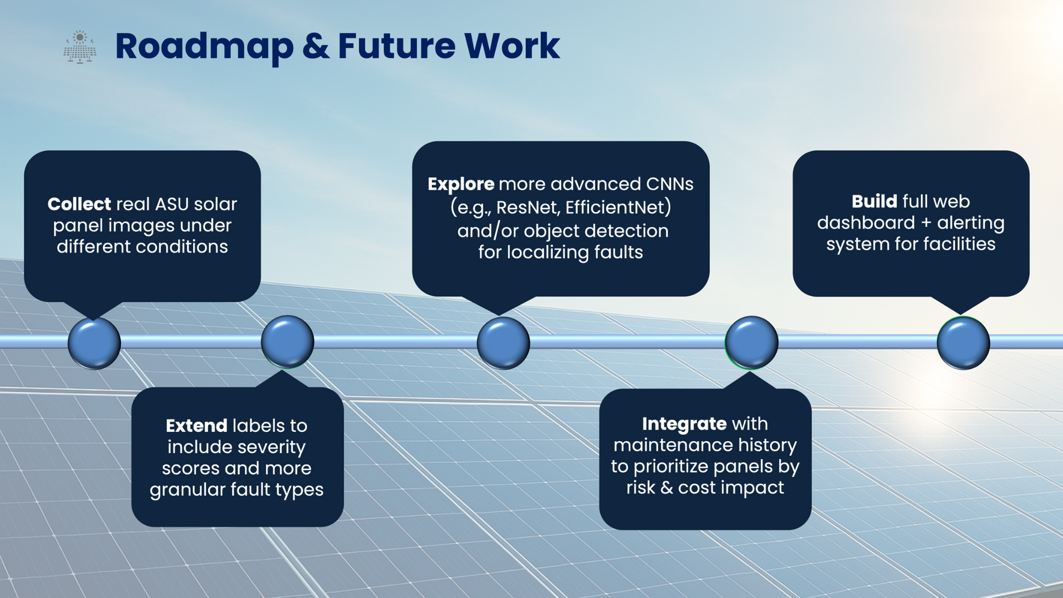

Slide 19
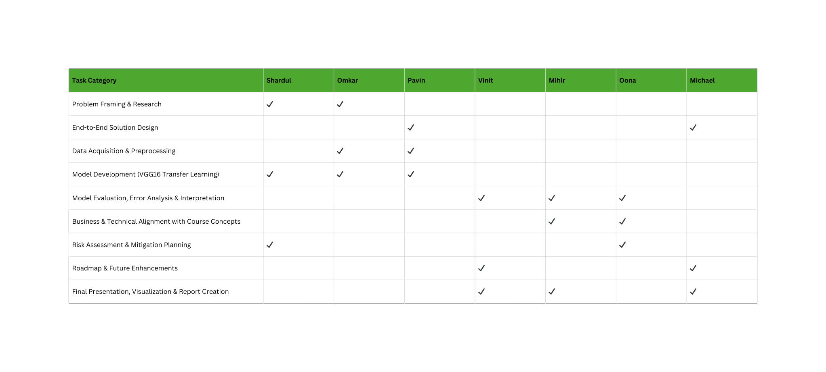
TEAM CONTRIBUTION CHART

Slide 20
References and Dataset
Open-Source Implementation (VGG19): VGG19 CNN Transfer Learning for fault Detection [Jupyter Notebook]. Kaggle. Retrieved from https://www.kaggle.com/code/pythonafroz/vgg19-cnn-transfer-learning-for-fault-detection/notebook
Open-Source Implementation (VGG16): CNN VGG16 used for Solar panel fault detection [Jupyter Notebook]. Kaggle. Retrieved from https://www.kaggle.com/code/pythonafroz/cnn-vgg16-used-for-solar-panel-fault-detection/notebook
Dataset Source Afroz. (n.d.). Solar Panel Images Clean and Faulty Images [Data set].
Kaggle. Retrieved from https://www.kaggle.com/datasets/pythonafroz/solar-panel-images

Slide 21
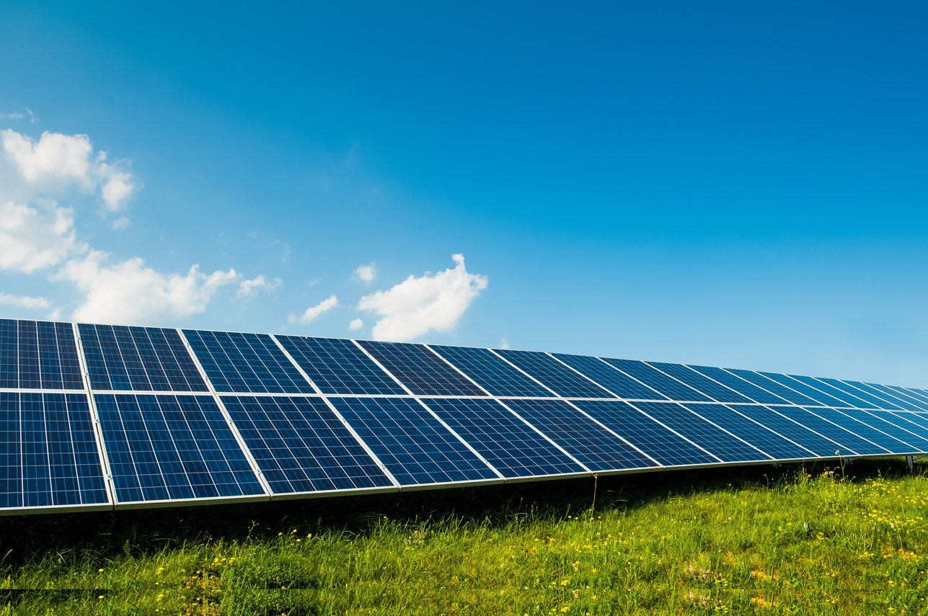
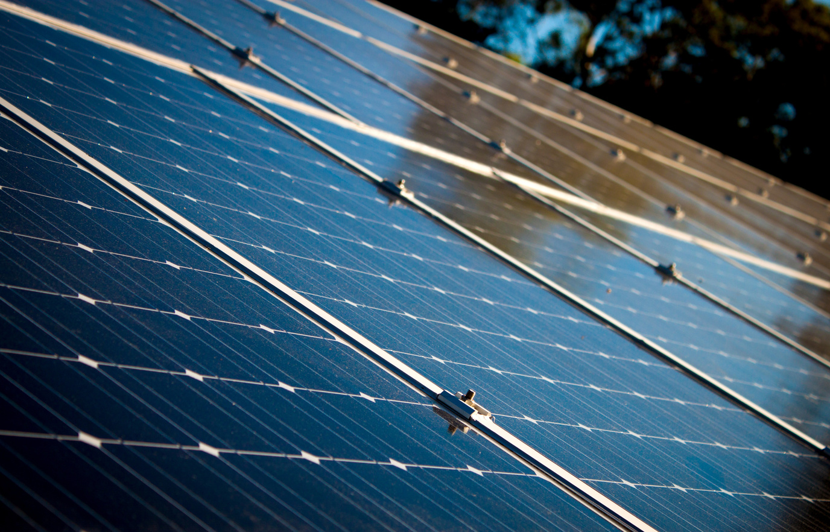
Thank You!
Q&A

